Slide 1
C++ Basics
Creative Commons Attribution-NonCommercial-ShareAlike 3.0 Unported License. http://creativecommons.org/licenses/by-nc-sa/3.0/
Written by Rachel J. Morris, last updated 2015-01-14

Slide 2

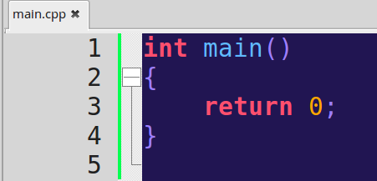
An empty C++ program
This is an empty C++ program – the bare minimum you need to get started.
The main() function is the starting point. Without it, you will get a compile error.

Slide 3
An empty C++ program
Start
End
The main() function is the starting point. Without it, you will get a compile error.
The return 0; is where the program ends. The 0 means that everything finished properly.

Slide 4
An empty C++ program
Start
End
The return 0; is a throwback to an old way of handling errors – 0 is no errors, and then returning any other number would stand for some error code.
Ever seen a program give you an error like
“Error code 201”
Which isn't helpful at all?

Slide 5

An empty C++ program
Start
End
This program will begin and end immediately.
We need to add more!

Slide 6
Variables
Creative Commons Attribution-NonCommercial-ShareAlike 3.0 Unported License. http://creativecommons.org/licenses/by-nc-sa/3.0/
Written by Rachel J. Morris, last updated 2015-01-14

Slide 7
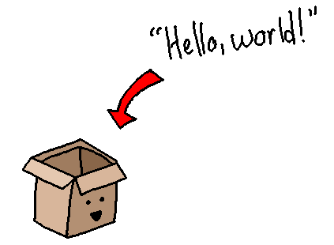
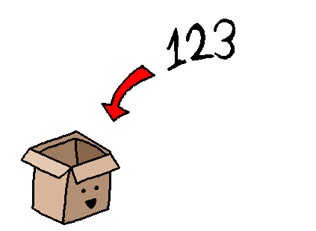
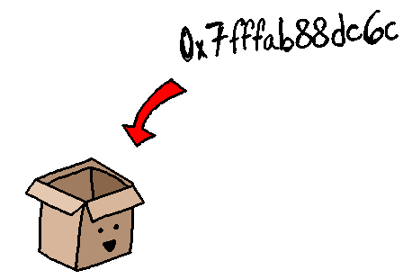
Variables
A variable is a place where you can store data.
Numbers, letters, text, memory addresses, etc.

Slide 8
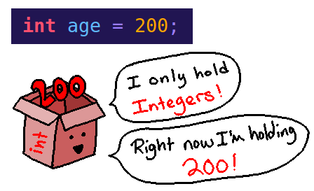
Variables
In C++, you must declare a variable before you can use it.
When you declare it, you must specify the data type and the name (identifier) for the variable.
Data Type
Identifier

Slide 9

Variables
If you do not initialize the variable with a value, it is initially stored with garbage.
Garbage is the term for a value at some memory address. When we create a new variable, we reuse a memory address that isn't being used anymore.
When something stops using memory, it doesn't necessarily clean up its data; it's just easier to leave it.

Slide 10
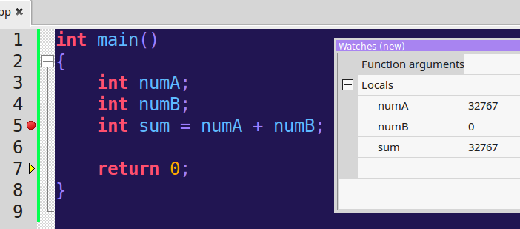
Variables
In this program, we have numA and numB, but never assigned a value.
numB got the value 0, but numA pulled a value from that memory address, so it is 32767.

Slide 11
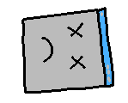
Variables
Having garbage data in your program (by not initializing variables) can create undefined behavior.
This means you can't predict what your program will do!

Slide 12



Variables
Here are a few ways we can declare a variable.
Declaring a variable, then assigning a value
Assigning a value on declaration
Declaring multiple integer variables at once

Slide 13
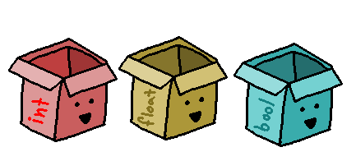
Data Types
Creative Commons Attribution-NonCommercial-ShareAlike 3.0 Unported License. http://creativecommons.org/licenses/by-nc-sa/3.0/
Written by Rachel J. Morris, last updated 2015-01-14

Slide 14
Data Types
Primitives (built-in)
Integer int
Float float
Boolean bool
Character char
C++ Standard Library
String string
Input
stream istream
Output
stream ostream
vector, list,
and more...

Slide 15


Data Types
Integer
Stores whole numbers – no decimals
Positive, negative, or zero

Slide 16

Data Types
Float
Stores numbers with decimal (or without decimal).
Positive, negative, zero.

Slide 17

Data Types
Boolean
Stores “true” or “false”.

Slide 18


Data Types
Character
Stores any one character:
Letter, number, symbol, key-code, etc.

Slide 19
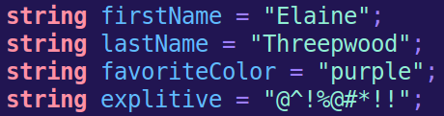

Data Types
String
(C++ Standard Library, requires the string library)
Stores (virtually) any amount of text – Letters, numbers, symbols, etc.

Slide 20
Input / Output
Creative Commons Attribution-NonCommercial-ShareAlike 3.0 Unported License. http://creativecommons.org/licenses/by-nc-sa/3.0/
Written by Rachel J. Morris, last updated 2015-01-14

Slide 21

Output
To use the cin (console-in) and cout (console-out) commands in C++, we need to first import a library...
To use another library, we use
#include <library_name>
iostream is for INPUT-OUTPUT streaming.

Slide 22
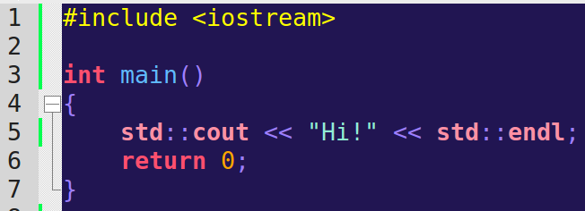
Output
Include library
Output “Hi” and end line
The cout command is part of the Standard Library.
We prefix cout here with std:: (standard) to specify the namespace it comes from.
endl stands for end-line. We have to manually specify where line-breaks are in C++.

Slide 23
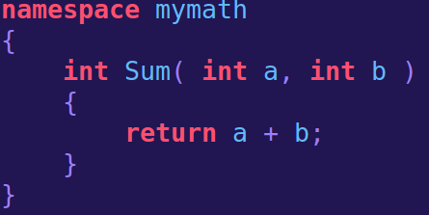
Namespace?
A Namespace is a way to group code together under a common name.
If you are using multiple libraries, it is possible that there could be naming collisions – two libraries using the same names for functions or variables!
The Standard Library has its functions in the std namespace.

Slide 24
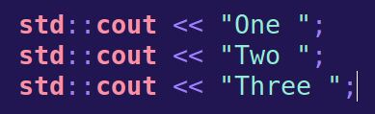
Namespace?
We will learn more about namespaces later.
Just remember that functionality from
iostream
(And other libraries we will use) are in the
std namespace.
We will learn more about namespaces later.

Slide 25
Output
We can get rid of these std:: prefixes by adding
using namespace std;
To the beginning of our program, outside of main().

Slide 26
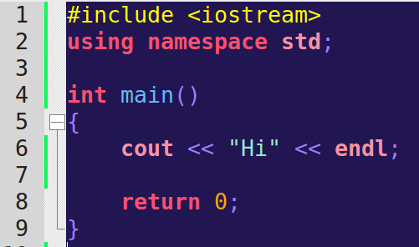
Output
We can get rid of these std:: prefixes by adding
using namespace std;
To the beginning of our program, outside of main().

Slide 27

Output
The << signs after cout is the Stream Operator.
Remember that, for console-output, the stream operator points towards the output.
We can keep linking string literals, variables, and endl end-lines together with the stream operator.

Slide 28



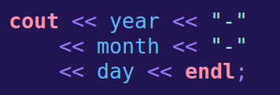

Output
Code
Output

Slide 29
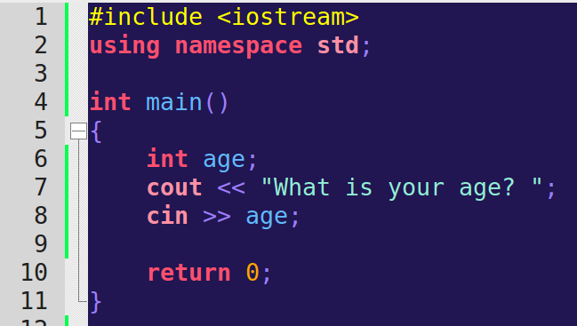
Input
To get input from the user, we can use
cin (console-in)
The >> signs after cin will point towards the variable, and away from the cin.

Slide 30
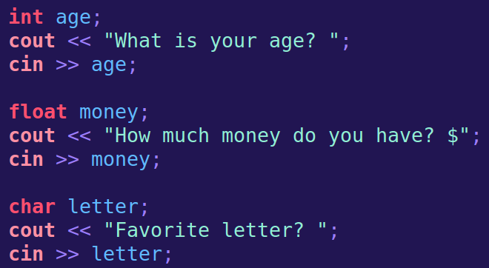
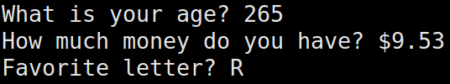
Input
Code
We can use cin with integers, floats, chars, strings, and other data types.
Output

Slide 31


Input
The text is flowing towards the console-out
The input is flowing from the console-input, towards the variable.

Slide 32
The String Data Type
Creative Commons Attribution-NonCommercial-ShareAlike 3.0 Unported License. http://creativecommons.org/licenses/by-nc-sa/3.0/
Written by Rachel J. Morris, last updated 2015-01-14

Slide 33

Data Types
The string data type requires that we include another library from the Standard Library.
A string is a string of characters – text, letters, numbers, anything.

Slide 34
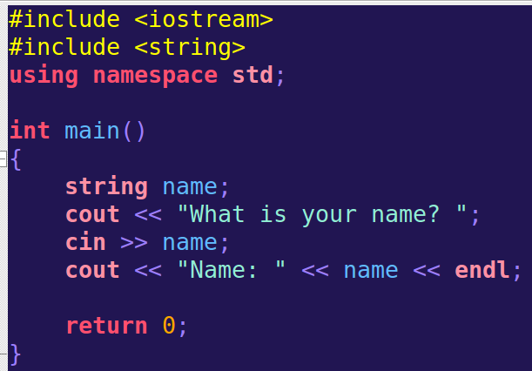
Data Types
We can also use cin to get a string from the user.
However...

Slide 35
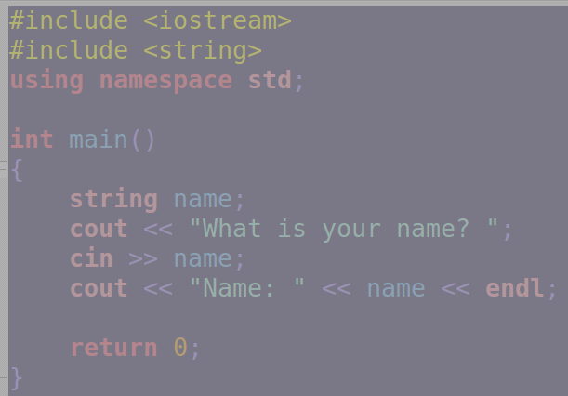

Data Types
The program only stores the first word here
Using cin this way only allows us to get any text, up to a blank space. Anything after the space may be passed to the next cin statement.

Slide 36
Types of Errors
Creative Commons Attribution-NonCommercial-ShareAlike 3.0 Unported License. http://creativecommons.org/licenses/by-nc-sa/3.0/
Written by Rachel J. Morris, last updated 2015-01-14

Slide 37

Types of Errors
There are various types of errors that you can experience when programming.
Let's go over these, so that you can learn to look out for these problems.

Slide 38
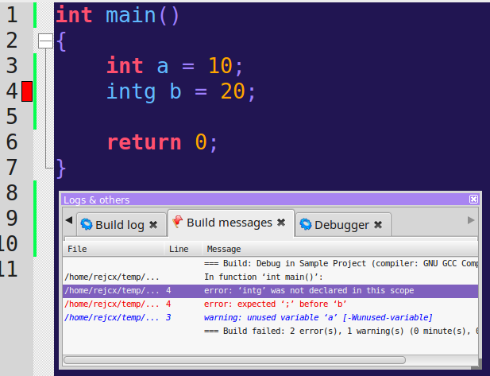

Types of Errors
A Syntax Error is when something in the language has been incorrectly typed.
The compiler can easily detect these errors, and you will receive a compile-time error.
The first error is the real error – intg isn't a data type, it is a typo of int.

Slide 39
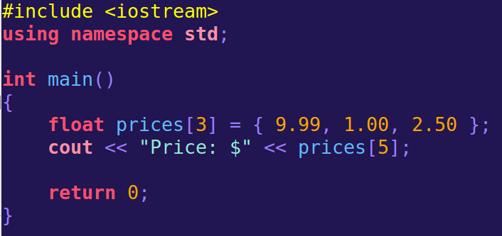


Types of Errors
A run-time error is something that is not “grammatically incorrect” in your program, but something breaks (or doesn't work as intended) while the program is running.

Slide 40



Types of Errors
A logic error is an error that doesn't break the program, but doesn't work as intended – it is an error in logic. It could simply be getting a formula wrong.
Area is actually width x height
When you run the program, it is clear that something is wrong, but you wouldn't know why without combing through the code.

Slide 41


Types of Errors
Syntax Error
The Syntax Error is easiest to find, since your program won't build unless your syntax is correct!
Run-Time Error
It might not be too difficult to spot Run-Time Errors, since your program may crash when you encounter one. Then you have to track down where it crashed...
Logic Error
Logic Errors are the hardest to diagnose, since the program will operate as written. The computer won't fact-check your formulas and algorithms for you. :)

Slide 42

So can we put it all together now?

